Slide 1



Telecom Churn Project Case Study
Analyzing Customer Retention in the Telecom Industry

Slide 2


Overview
The telecom industry faces significant challenges with customer churn. This project aims to understand the factors contributing to churn and develop predictive models to identify at-risk customers. By leveraging data analytics, we aim to provide actionable insights to reduce churn and improve customer retention
The tools and techniques used are Power BI and MySQL.
Objective
The main goal of this project is to reduce customer churn, secondary goals is understanding customer demographics and identifying churn reasons
Scope
Analyze customer demographics, usage patterns, and service-related data.
Conduct exploratory data analysis (EDA) for initial insights.
Engineer relevant features to enhance predictive power.
Evaluate machine learning models to determine the best approach.
Interpret results to provide actionable recommendations.
Implement the model and monitor its performance for continuous improvement.

Slide 3

Data Sources
Data: This includes data on the customer, types of services as well as the reason for churned customers
CSV File – customer_churn: This file contains detailed rider data necessary for the analysis.

Slide 4
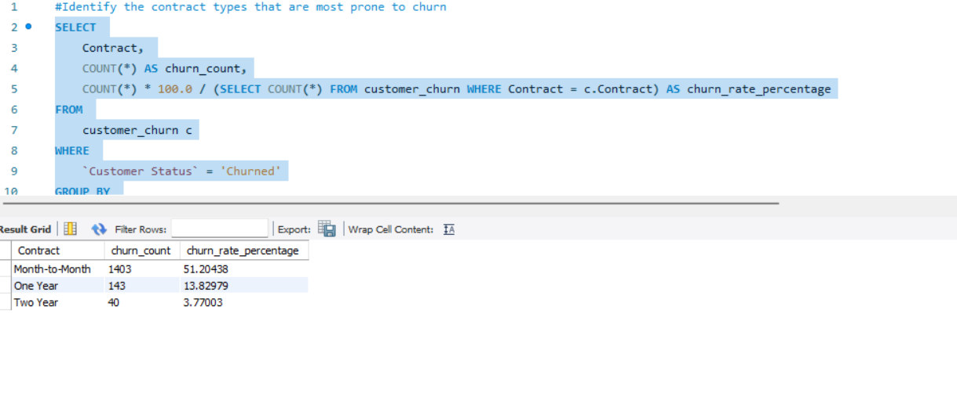
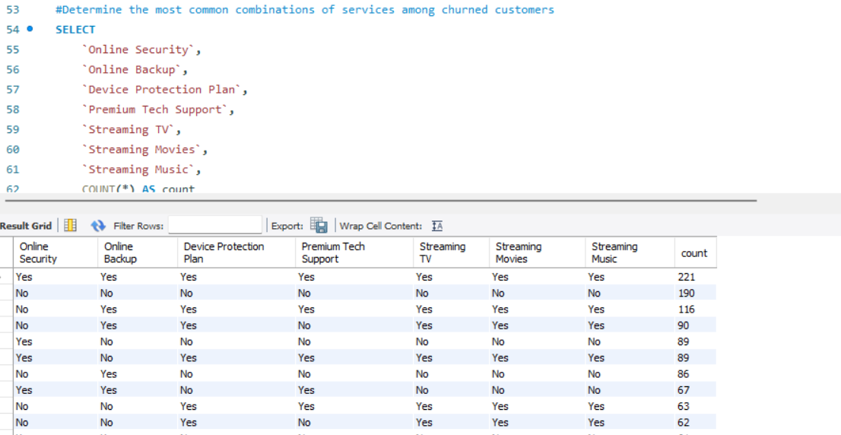
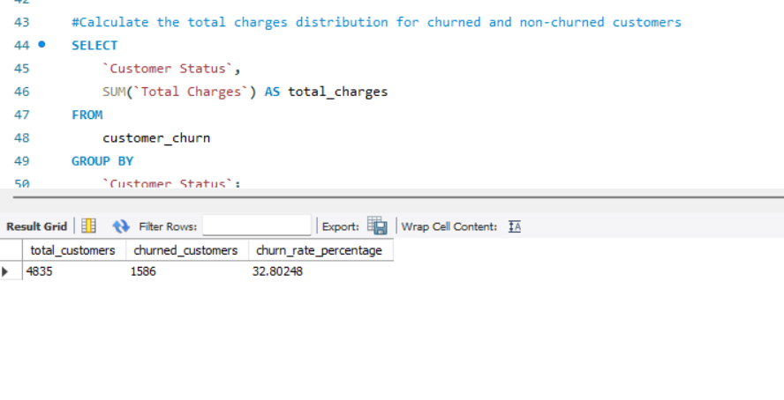
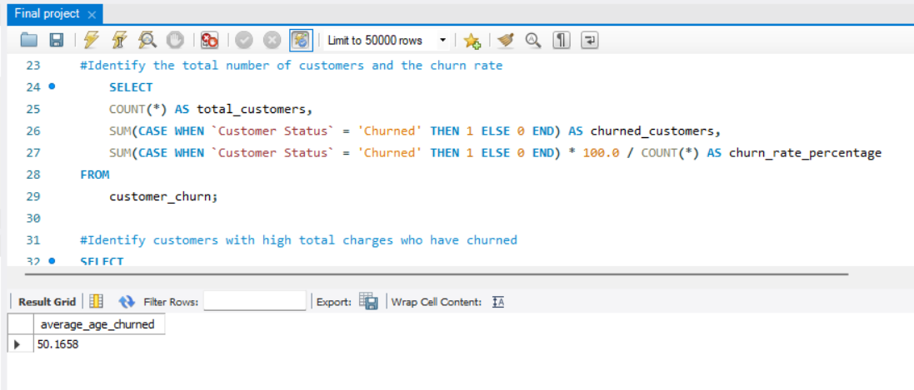

Slide 5
Methodology
Steps taken in the analysis are :-
Data collection,
Data cleaning,
Exploratory data analysis,
visualization, and insights

Slide 6
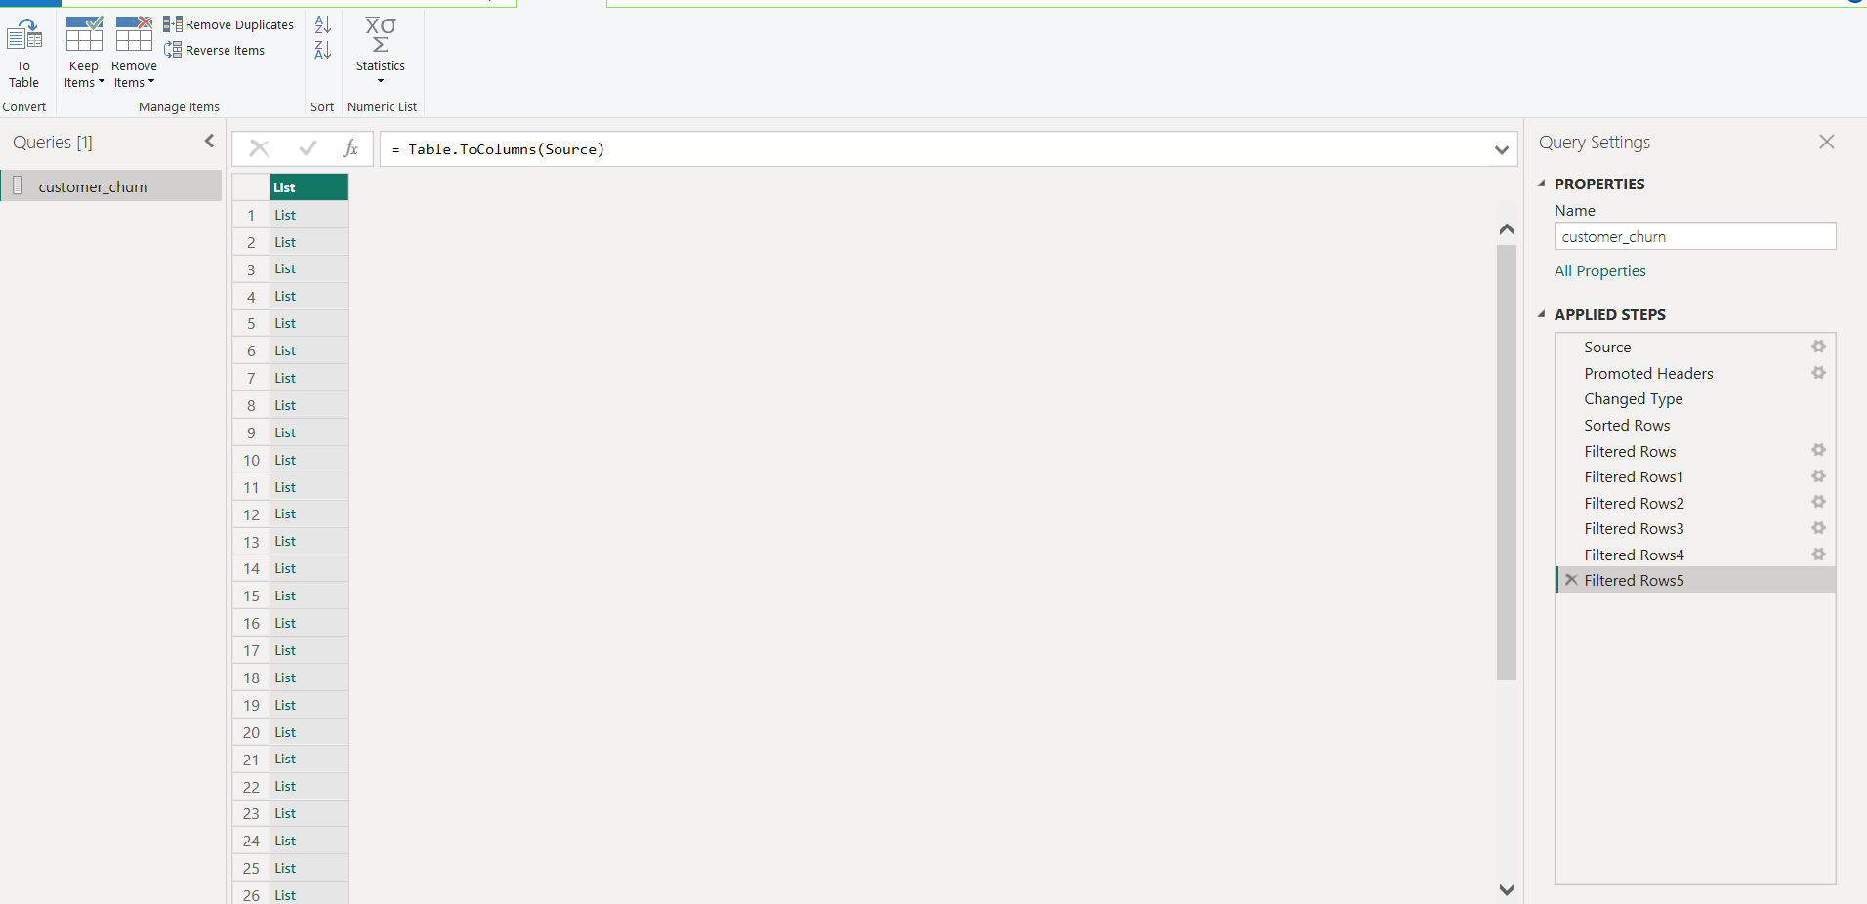
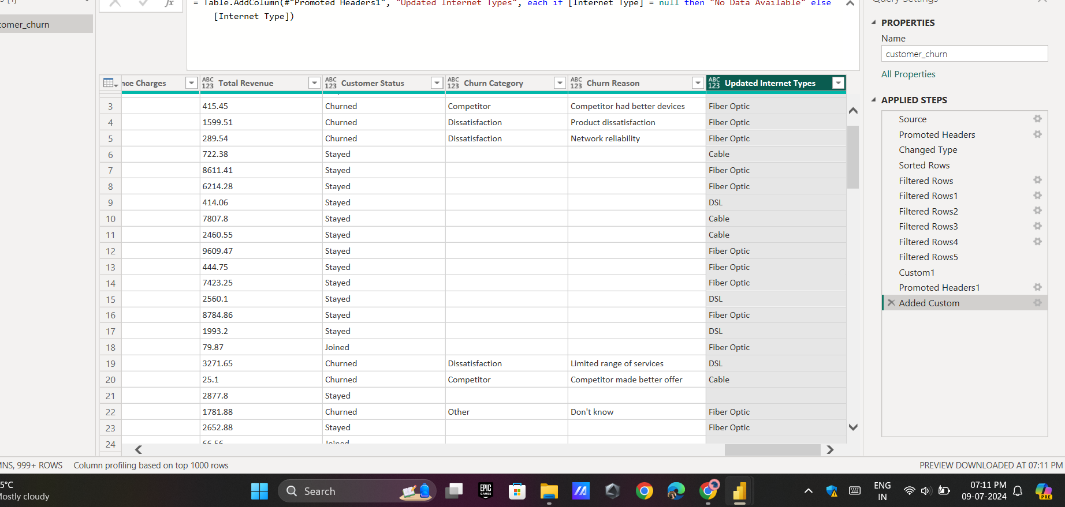

Slide 7
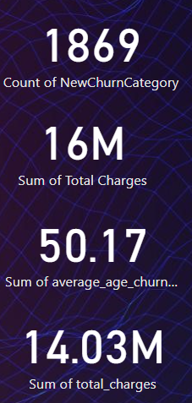
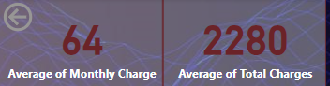
Data Overview
Present key metrics like total number of customers, churn rate, and average charges.

Slide 8
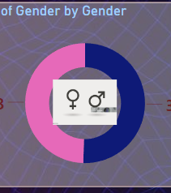
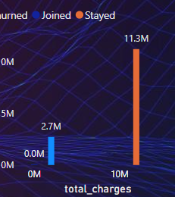
Demographic Analysis

Slide 9
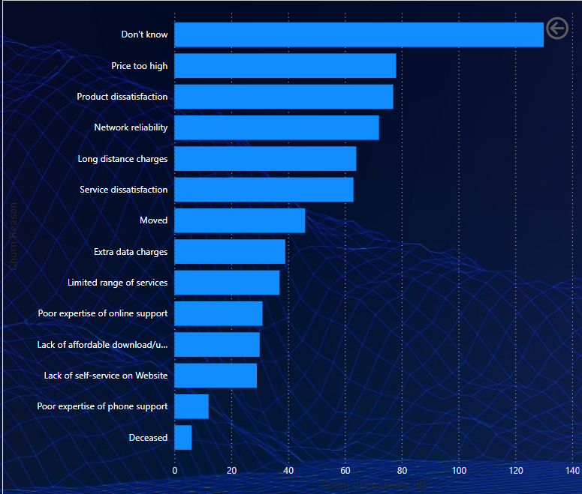
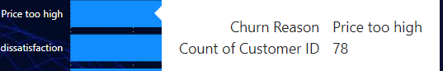
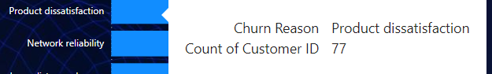
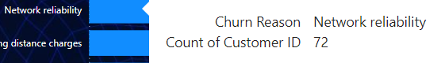
Churn Reasons

Slide 10
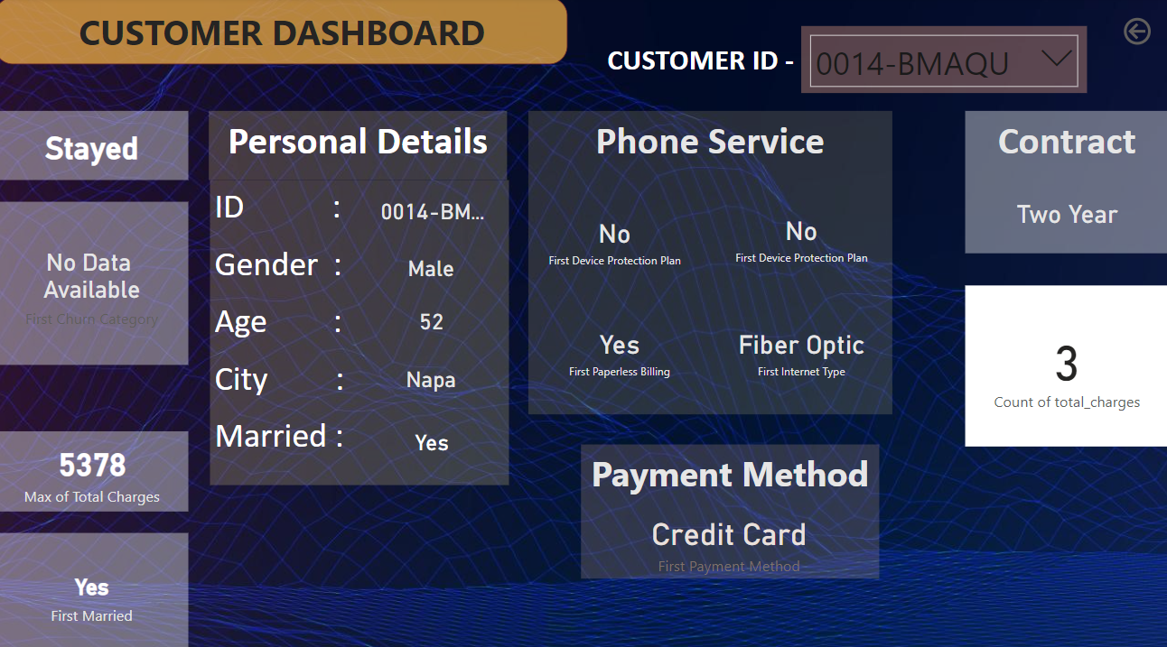
Customer Profiles

Slide 11
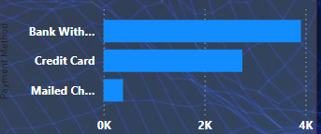
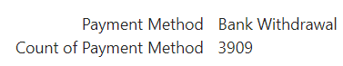
Payment Methods Analysis

Slide 12
Phone Service Analysis
Internet Service:
Yes: 5.5K customers
No: 1.5K customers
Analysis:
The majority of customers have internet service. A detailed churn rate comparison between those who have and those who don't could reveal the impact on churn.
Online Security:
No: 3.5K customers
Yes: 2K customers
Analysis:
A significant number of customers lack online security. The churn rate among these customers can indicate whether online security features help in retention.
Premium Tech Support:
No: 3.5K customers
Yes: 2K customers
Analysis:
Premium tech support is another critical feature. Comparing churn rates between customers with and without this support will highlight its importance.

Slide 13
Key Insights:
Internet service is widely used, making it a baseline service.
Online security and premium tech support significantly impact churn, suggesting these features should be emphasized or improved.
Actionable Recommendations:
Enhance online security features and promote them to customers.
Offer premium tech support as a value-added service to reduce churn.

Slide 14
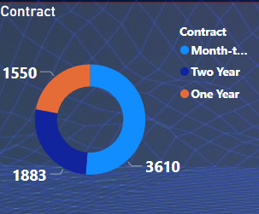
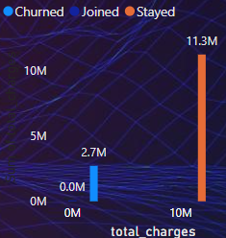
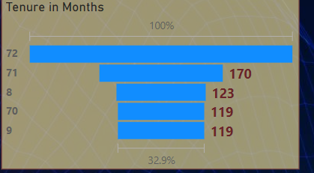
Contract Types

Slide 15

Actionable Recommendations to Reduce Churn
1. Addressing Top Churn Reasons:
Price Too High:
Recommendation: Implement flexible pricing plans and discounts for long-term contracts.
Action Steps:
Introduce tiered pricing based on usage.
Offer loyalty discounts and promotions.
Product Dissatisfaction:
Recommendation: Enhance product quality and features based on customer feedback.
Action Steps:
Conduct regular surveys and focus groups.
Implement feedback loops to incorporate suggestions into product development.
Network Reliability:
Recommendation: Invest in infrastructure to improve network reliability and coverage.
Action Steps:
Identify and upgrade weak network areas.
Provide backup solutions during outages.

Slide 16

Service and Experience Enhancement:
Improve Self-Service Options:
Recommendation: Develop intuitive self-service portals and mobile apps.
Action Steps:
Enhance the user interface and experience of self-service platforms.
Provide comprehensive FAQs and tutorial videos.
Increase Service Offerings:
Recommendation: Expand the range of services offered to meet diverse customer needs.
Action Steps:
Introduce new services based on market trends and customer demands.
Continuously innovate and update existing services.

Slide 17
Thank YOu

